Slide 1
WPF Validation

Slide 2
If you know all this… then feel free to leave
How to do binding validation with:
Validation Rules
Exceptions
IDataErrorInfo
Validation Application Block
Markup Extensions

Slide 3
Sample
App to create a list of party invitees
Rules for being an Invitee
Name is required
Age has to be greater than 18
Must have a valid email address

Slide 4
Using Validation Rules

Slide 5
Validation Rules
Validation Rules are the mechanism built into databinding with WPF

Slide 6

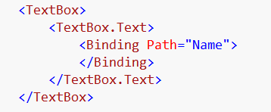
Binding – Markup Extension
Normally you see binding as
but that is just a binding markup extension.
We can also set a binding like this

Slide 7
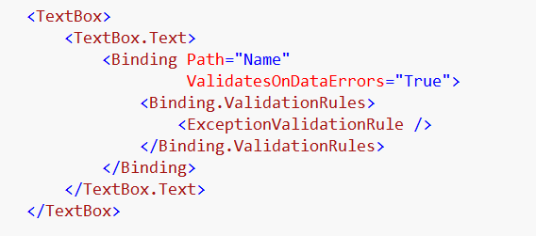
Add Validation Rules to Binding
Binding needs to Validate on Data Error
Allows the setting of Validation Rules to Binding

Slide 8
What Validation Rules come with WPF
DataErrorValidationRule
ExceptionValidationRule

Slide 9
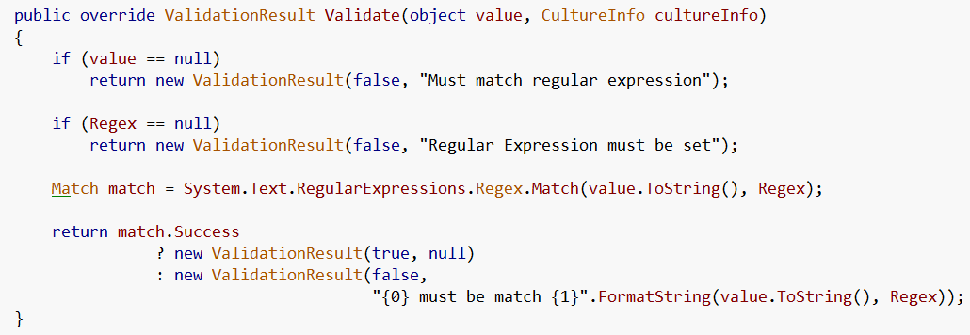
Custom Validation Rules
Just inherit from Validation Rule
And override Validate method …

Slide 10
Implement Validate and return ValidationResult
Fail
Pass
Validation Error Message

Slide 11
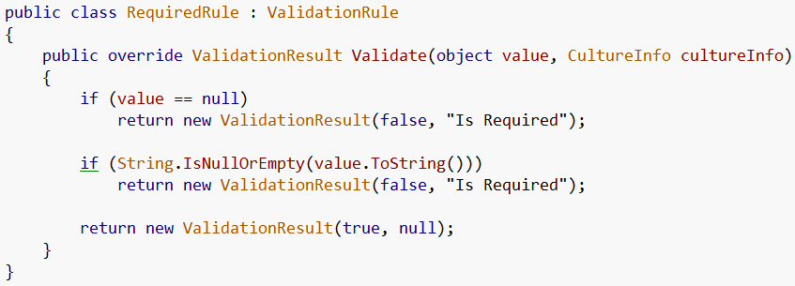
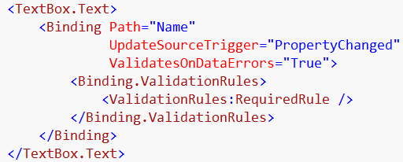
Required

Slide 12
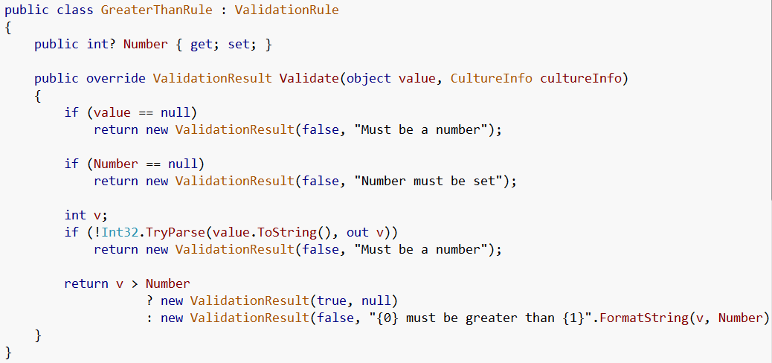
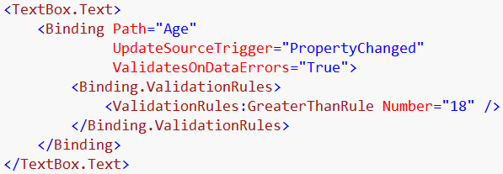
Greater Than

Slide 13
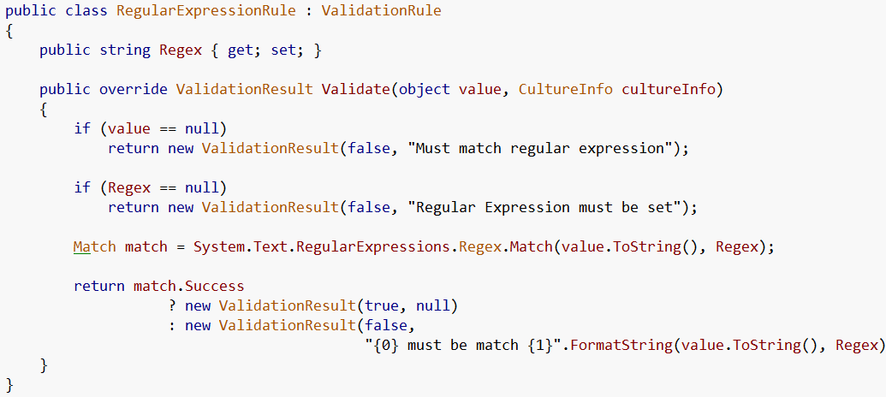
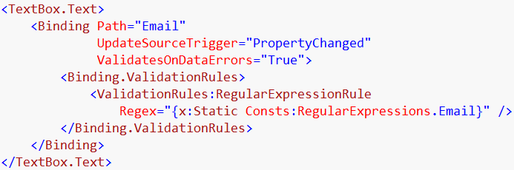
Regular Expression

Slide 14
Displaying the Errors

Slide 15
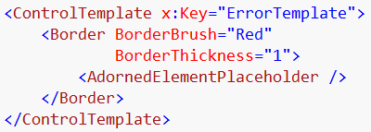
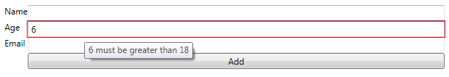
Error Template
Creates the red border

Slide 16
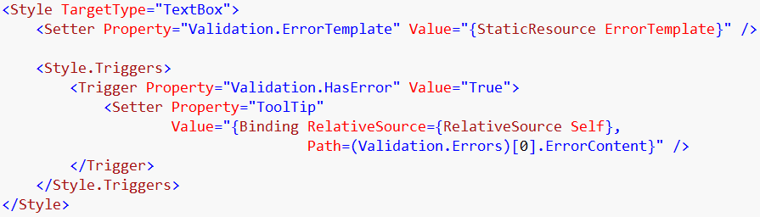
Displaying Error Message
This is setting the error template we specified
This trigger sets the tooltip to the error message

Slide 17
Using Exceptions

Slide 18
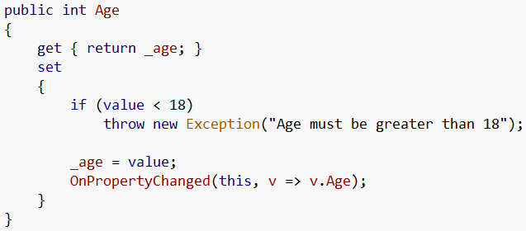
On source…
Throw exception
Exception message will be the error content

Slide 19
On binding…
Set ValidatesOnExceptions

Slide 20
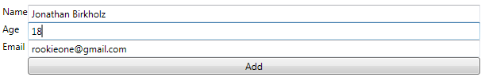


Exception Messages
Hmm… not exactly the error message we would want…
Although nice to report.. The message is lame

Slide 21
Using IDataErrorinfo

Slide 22

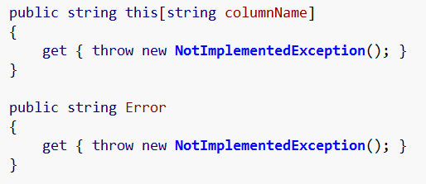
Implement

Slide 23
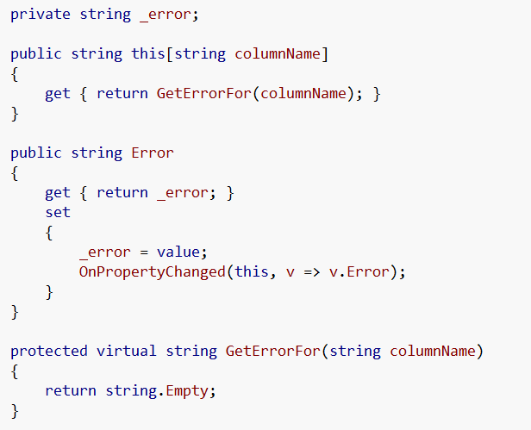
On base ViewModel

Slide 24
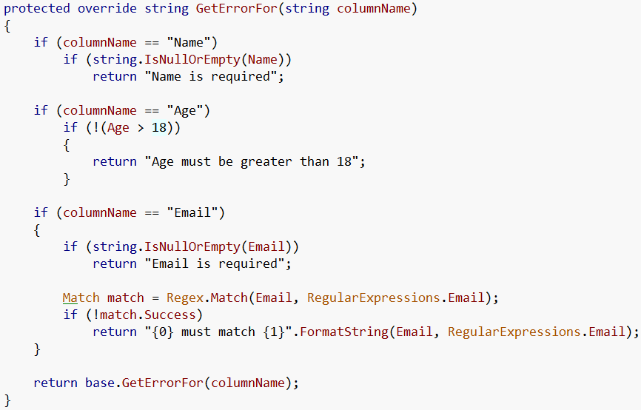
On Party Invitee View Model

Slide 25
On Binding
Validates On Data Errors

Slide 26

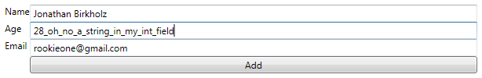
Works great right?
Not quite so perfect….
Bad input… no error

Slide 27
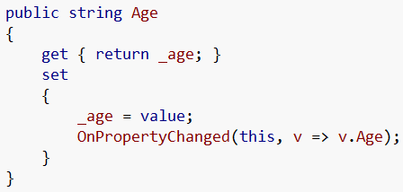
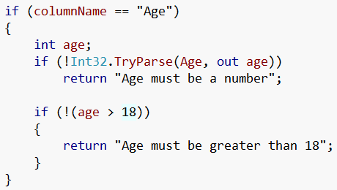
Solution
Make Age a string
Change Error Checking

Slide 28
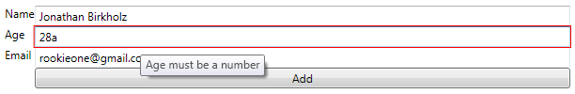
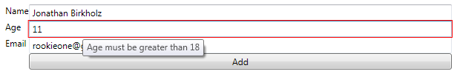

And now…

Slide 29
Enterprise Library

Slide 30
Enterprise Library is
The Microsoft Enterprise Library is a collection of application blocks designed to assist developers with common enterprise development challenges
One of which is the Validation Block

Slide 31
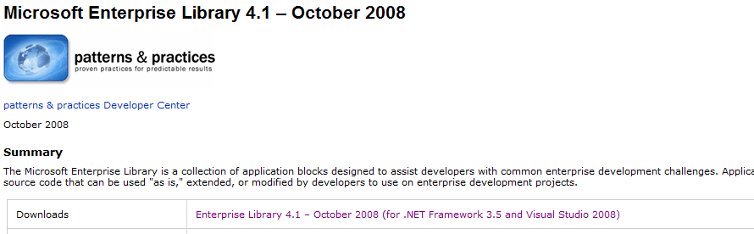
You can get EntLib 4.1 here
http://msdn.microsoft.com/en-us/library/dd203099.aspx

Slide 32
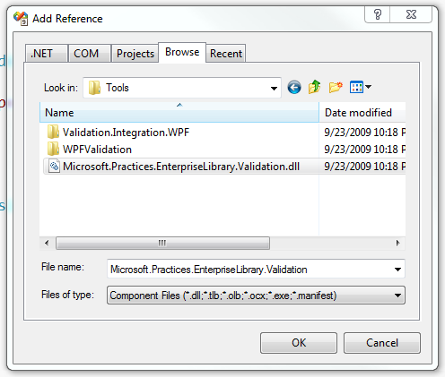
Add Reference

Slide 33
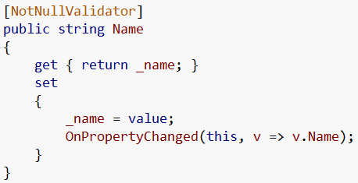
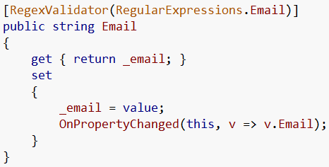
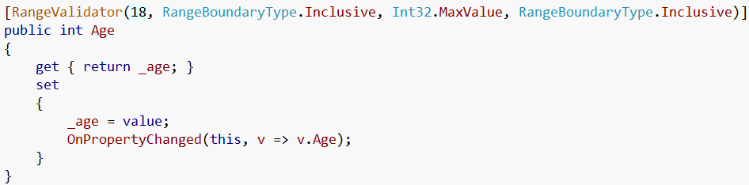
Use Validation Attributes

Slide 34
On Binding
Validates On Data Errors

Slide 35
Custom markup extension

Slide 36
Markup Extensions
The most common markup extensions used in WPF programming are those that support resource references (StaticResource and DynamicResource), and those that support data binding (Binding)
Static Resource
Dynamic Resource
Binding

Slide 37
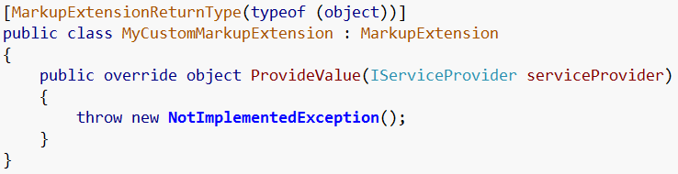
Custom Markup Extensions
We can make our own markup extensions
Use attribute to specify markup extension return type
Inherit from MarkupExtension
Implement ProvideValue

Slide 38
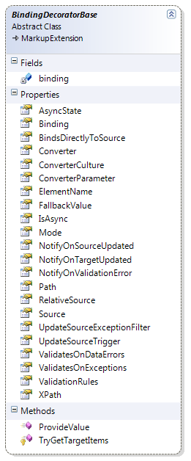
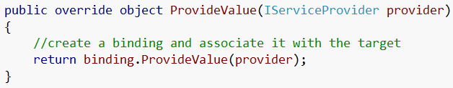
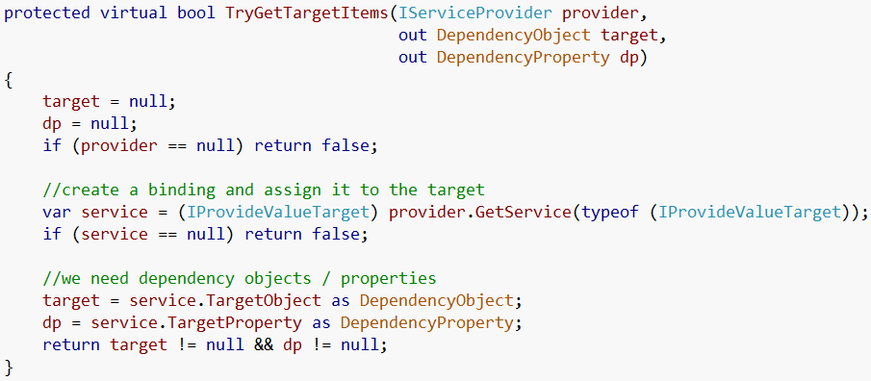
Binding Decorator Base
Copied from Philip Sumi @
http://www.hardcodet.net/2008/04/wpf-custom-binding-class

Slide 39
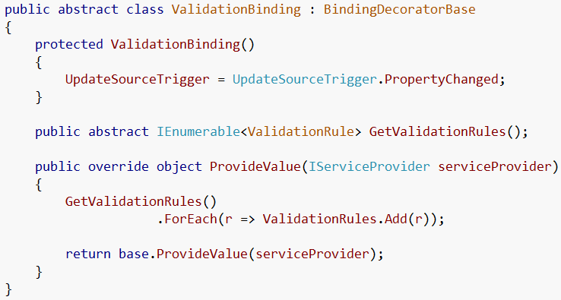
Base Validation Binding

Slide 40
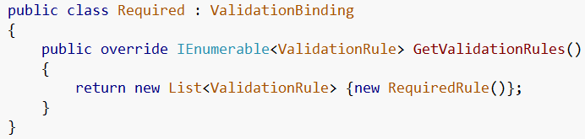
Required
Implementation
Xaml

Slide 41
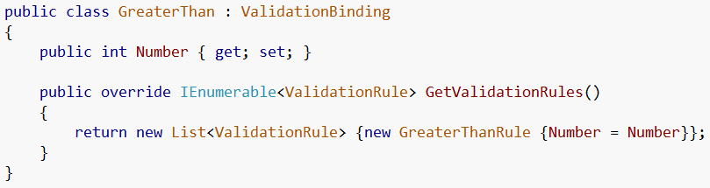
Greater Than
Implementation
Xaml

Slide 42
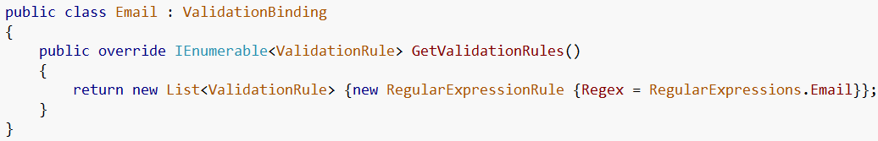
Email
Implementation
Xaml

Slide 43
References
MSDN
http://msdn.microsoft.com/en-us/library/dd203099.aspx
Josh Smith
Karl Shifflet
Philip Sumi

